Slide 1
Instruction Set Principles

Slide 2
Objective and Reading
Objective
understand issues and tradeoffs in instruction set design
Reading
Computer Architecture: A Quantitative Approach
Appendix A
recommended: Computer Organization and Design: The Hardware/Software Interface
Chapter 2

Slide 3
Abstractions
Instruction set architecture (ISA)
The hardware/software interface
Defines storage, operations, etc
Abstraction helps to deal with complexity
Hide lower-level detail
Implementation
The details underlying the interface
An ISA can have multiple implementations
Problem
Algorithm
Program/Language
User
Runtime System
(VM, OS, MM)
ISA
Microarchitecture
Logic
Circuits
Electrons
A.1 Introduction

Slide 4
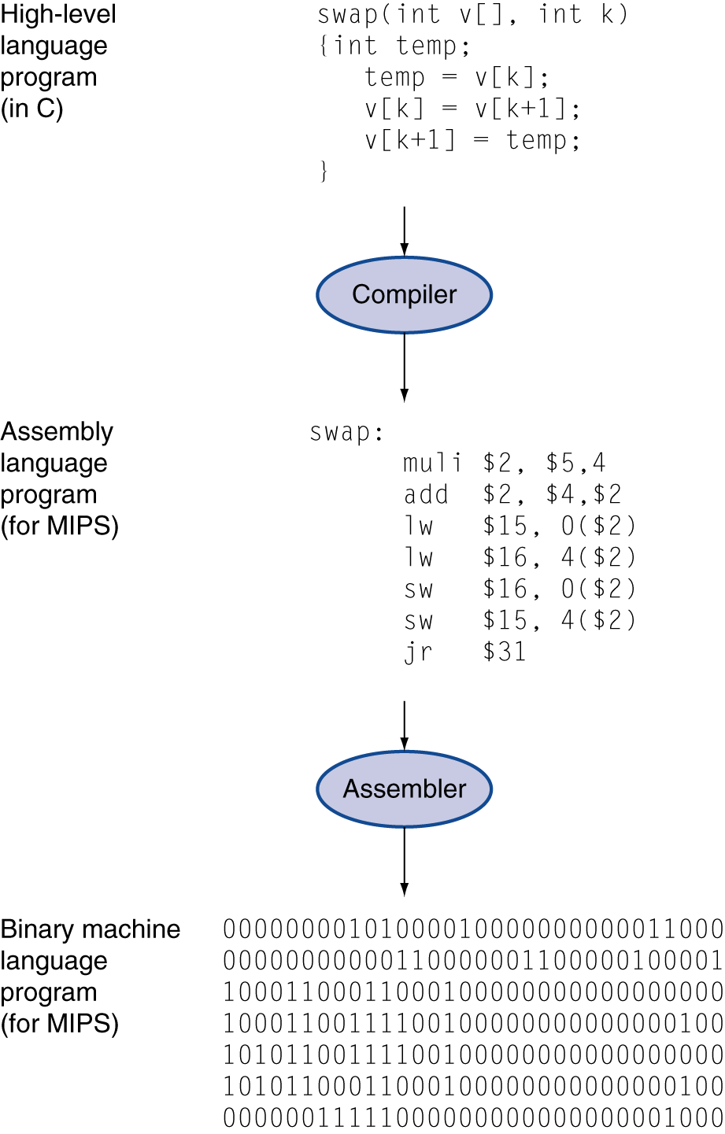
Levels of Program Code
High-level language
Level of abstraction closer to problem domain
Provides for productivity and portability
Assembly language
Textual representation of instructions
Hardware representation
Machine code - Binary digits (bits)
Encoded instructions and data
Compiler
Translate HL prgm to assembly
Assembler
Translate assembly to machine code
A.1 Introduction

Slide 5
Program Execution Model
uP
A computer is just a FSM
States stored in registers, memory, PC, etc
States changed by instruction execution
An instruction is executed in
Fetch an instruction into CPU from memory
Decode it to generate control signals
Execute it (add, mult, etc)
Write back output to reg or memory
Programs and data coexist in memory
How to distinguish program from data?
Mem
Fetch
Decode
Execute
Writeback
A.1 Introduction
Notes:
programs are accessed through special addresses: program counter.

Slide 6
What Makes a Good ISA?
Programmability
Who does assembly programming these days?
Performance/Implementability
Easy to design high-performance implementations?
Easy to design low-power/energy implementations?
Easy to design low-cost implementations?
Compatibility
Easy to maintain as languages, programs evolve
x86 (IA32) generations: 8086, 286, 386, 486, Pentium, Pentium-II, Pentium-III, Pentium4, Core2, Core i7, ...
A.1 Introduction
Notes:
Programmability: less important as compiler can produce code with higher quality.
X86: X86 compatible instructions that are translated into MIPS-like operations internal for performance.

Slide 7
Performance
Execution time = IC * CPI * cycle time
IC: instructions executed to finish a program
Determined by program, compiler
CPI: number of cycles needed for each instruction
Determined by compiler, micro-architecture
Cycle time: inverse of clock frequency
Determined by micro-arch. & technology
Ideally optimize all three
Their optimizations often against each other
Compiler plays a significant role in reducing IC
A.1 Introduction

Slide 8
Instruction Granularity
opcode | operand 1 | operand 2 | … | operand n
CISC (Complex Instruction Set Computing) ISAs
Big heavyweight instructions (lots of work per inst)
Low “inst/program” (IC)
Higher “cycles/inst” (CPI) & “seconds/cycle” (Cycle T)
RISC (Reduced Instruction Set Computer) ISAs
Minimalist approach to an ISA: simple inst only
Low CPI and “seconds/cycle” (Cycle T)
Higher IC, but hopefully not as much
Rely on compiler optimizations
A.1 Introduction
Notes:
CISC example: array add instruction
RISC: give more freedom to compiler for optimization

Slide 9
Classifying Architectures
One important classification scheme is by the type of addressing modes supported.
Stack architecture: Operands implicitly on top of a stack. (Early machines, Intel floating-point.)
Accumulator architecture: One operand is implicitly an accumulator (a special register).
early machines
General-purpose register arch.: Operands may be any of a large (typically 10s-100s) # of registers.
Register-memory architectures: One op may be memory.
Load-store architectures: All ops are registers, except in special load and store instructions.
A.2 ISA Classification
Notes:
Addressing mode: how operands are found in processor/memory

Slide 10
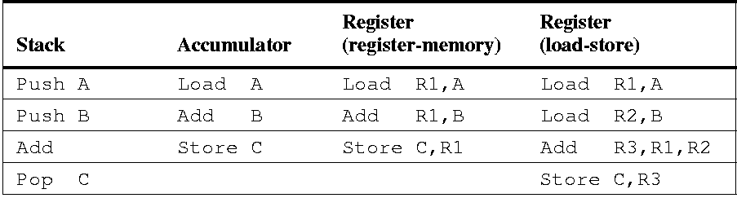
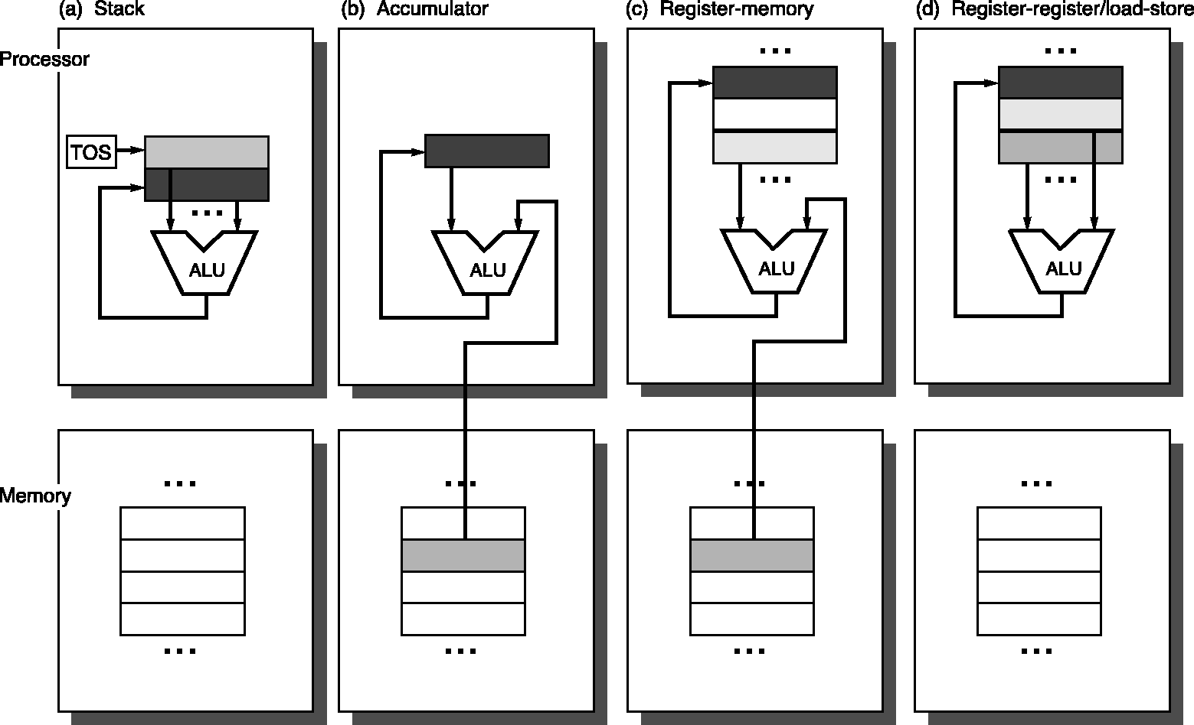
Illustrating Architecture Types
Assembly for C:=A+B:
A.2 ISA Classification

Slide 11
Number of Registers
Registers have advantages
faster than memory, good for compiler optimization, hold variables
So have as many registers as possible?
No – why?
One reason that registers are faster:
There are fewer of them – small is fast (hardware truism)
Another reason: they are directly addressed
More registers, means more bits per register in instruction
Thus, fewer registers per instruction or larger instructions
More registers means more saving/restoring
Across function calls, traps, and context switches
Trend toward more registers:
8 (x86) → 16 (x86-64), 16 (ARM v7) → 32 (ARM v8)
A.2 ISA Classification

Slide 12
Number of Operands
A further classification is by the max. number of operands, and # of operands that can be memory: e.g.,
2-operand (e.g. a += b)
src/dest(reg), src(reg)
src/dest(reg), src(mem) IBM 360, x86, 68k
src/dest(mem), src(mem) VAX
3-operand (e.g. a = b+c)
dest(reg), src1(reg), src2(reg) MIPS, PPC, SPARC, RSIC-V.
dest(reg), src1(reg), src2(mem)
dest(mem), src1(mem), src2(mem) VAX
Types of General Purpose Register Computers
register-register (load-store)
register-memory
memory-memory
A.2 ISA Classification
Notes:
More than 3 operands would make instruction encoding complex

Slide 13
Memory Addressing
Byte Addressing
Each byte has a unique address
Other addressing units
Half-word: 16-bit (or 2 bytes)
Word: 32-bit (or 4 bytes)
Double word : 64-bit (or 8 bytes)
Quad word: 128-bit (or 16 bytes)
Two issues
Alignment specifies whether there are any boundaries for word addressing
Byte order (Big Endian vs. Little Endian)
specifies how multiple bytes within a word are mapped to memory addresses
A.3 Memory Addressing
Notes:
memory addressing --- how memory addresses are specified, and how they are interpreted to find data.

Slide 14
Memory Addressing
Alignment
Half word, words, double words begin at mod 2, mod 4, mod 8 boundaries
half word
#mod 2
Word
#mod 4
Double word
#mod 8
Aligned if Addr mod size = 0
A.3 Memory Addressing

Slide 15
Memory Addressing
Alignment
Or there no alignment restrictions
half word
Word
Double word
A.3 Memory Addressing
Notes:
how to access byte, half word and word in a 64-bit machine?

Slide 16
Memory Addressing
Non-aligned memory references may cause multiple memory accesses
Consider a system in which memory reads return 4 bytes and a reference to a word spans a 4-byte boundary: two memory accesses are required
Complicates memory and cache controller design
Assemblers typically force alignment for efficiency
A.3 Memory Addressing
Notes:
Modern memory accesses are aligned along word or double-word. To access mis-aligned word, it will take multiple aligned accesses.

Slide 17
Byte Ordering – Big Endian
The most significant byte within a word (or half word or double word) is stored at the lowest address
A.3 Memory Addressing

Slide 18
Byte Ordering – Little Endian
The least significant byte within a word (or half word or double word) is stored in the smallest address
A.3 Memory Addressing
Notes:
byte ordering – how bytes within a word are placed in memory

Slide 19
Byte Orders in Real Systems
Big Endian: Motorola 68000, Sun Sparc, PDP-11
Little Endian: VAX, Intel IA32
Configurable: MIPS, ARM
No difference within a single machine
A.3 Memory Addressing

Slide 20
Addressing Modes – How to Find Operands
A.3 Memory Addressing
Notes:
about ways specifying addresses of operands in instructions
Operands can be constant, in registers, or in memory.
Define “effective address” – base + offset

Slide 21
Addressing Modes
Addressing modes can reduce IC but
At a cost of added CPU design complexity and/or
Increase average CPI
Example – memory indirect
Add R1, @(R3)
equivalently,
load R2, Mem[R3]
load R4, Mem[R2]
Add R1, R1, R4
A.3 Memory Addressing
Notes:
Some early instructions can perform array-array operations in a single instruction

Slide 22
Which Addressing Modes to Support
Support frequently used modes
Make common case fast!
A.3 Memory Addressing
Notes:
Expensive to support all addressing modes

Slide 23
Displacement Value Distribution
add R4 100(R1) – 16 bits to be sufficient
SPEC CPU2000 on Alpha
A.3 Memory Addressing

Slide 24
Popularity of Immediate Operands
add R4 #3
SPEC CPU2000 on Alpha
A.3 Memory Addressing

Slide 25
Distribution of Immediate Values
add R4 #3 – 16 bits to be sufficient
SPEC CPU2000 on Alpha
A.3 Memory Addressing

Slide 26
Other Issues
How to specify type and size of operands (A.4)
Mainly specified in opcode – no separate tags for operands
Operations to support (A.5)
simple instructions are used the most
Control flow instructions (A.6)
Branch, call/return more popular than jump
Target address is typically PC-relative & register indirect
Address displacements are usually <= 12 bits
How to implement conditions for branches

Slide 27
Instruction Encoding
Affects code size and implementation efficiency
OpCode – Operation Code
The instruction (e.g., “add”, “load”)
Possible variants (e.g., “load byte”, “load word”…)
Operands – source and destination
Register, memory address, immediate
Addressing Modes – Impacts code size
Encode as part of opcode (common in load-store architectures which use a few number of addressing modes)
Address specifier for each operand (common in architectures which support may different addressing modes)
A.7 Instruction Encodings

Slide 28
Instruction Encoding
length: 1 – 17 bytes
A.7 Instruction Encodings
Notes:
encoding affects
code size
implementation efficiency
Typical encoding: opcode + operands

Slide 29
Fixed vs Variable Length Encoding
Fixed Length
Simple, easily decoded
Larger code size
Variable Length
More complex, harder to decode
More compact, efficient use of memory
Fewer memory references
Advantage possibly mitigated by use of cache
Complex pipeline: instructions vary greatly in both size and amount of work to be performed
A.7 Instruction Encodings

Slide 30
Instruction Encoding
Tradeoff between variable and fixed encoding is size of program versus ease of decoding
Must balance the following competing requirements:
Support as many registers and addressing modes as possible
Impact of the number of registers and addressing mode fields on the average instruction size
Desire to have instructions encoded into lengths that will be easy to handle in a pipelined implementation
Multiples of bytes than arbitrary # of bits
Many desktop and server choose fixed-length instructions
?
A.7 Instruction Encodings
Notes:
Desktop/servers usually have large memory, so the code size is less of a concern
Embedded systems have more constrained memory, code size is more significant.

Slide 31
Putting it Together
Use general-purpose registers with load-store arch
Addressing modes: displacement, immediate, register indirect
Data size: 8-, 16-, 32-, and 64-bit integer, 64-bit floating
Simple instructions: load, store, add, subtract, …
Compare: =, /=, <
Fixed instruction for performance, variable instruction for code size
At least 16 registers
Read section A9 to get an idea of RISC-V ISA.
Useful for understanding following discussions on pipelining

Slide 32
Pitfalls
Designing “high-level” instruction set features to support a high-level language structure
They do not match HL needs, or
Too expensive to use
Should provide primitives for compiler
Innovating at instruction set architecture alone without accounting for compiler support
Often compiler can lead to larger improvement in performance or code size

Slide 33
A.9 RISC-V Architecture

Slide 34
RISC Philosophy
Keep the instruction set small and simple, in order to build fast hardware
Let software do complicated operations by composing simpler ones
give compiler freedom to optimize
A.9 RISC-V Architecture

Slide 35
What is RISC-V?
Fifth generation of RISC ISA from UC Berkeley
A high-quality, license-free, royalty-free RISC ISA specification
Experiencing rapid uptake in both industry and academia
Both proprietary and open-source core implementations
Supported by growing shared software ecosystem
Appropriate for all levels of computing system, from microcontrollers to supercomputers
32-bit, 64-bit, and 128-bit variants
Standard maintained by non-profit RISC-V Foundation
A.9 RISC-V Architecture

Slide 36
What is RISC-V?
Not "over-architecting” for
a particular microarchitecture style (e.g., microcoded, in-order, decoupled, out-of-order) or
implementation technology (e.g., full-custom, ASIC, FPGA), but which allows efficient implementation in any of these
RISC-V ISA includes
A small base integer ISA, usable by itself as a base for customized accelerators or for educational purposes, and
Optional standard extensions, to support general-purpose software development
Optional customer extensions
A.9 RISC-V Architecture

Slide 37
RISC-V ISAs
Base ISAs
RV32I: base 32-bit integer instructions (32b registers)
RV32E: base 32-bit integer instructions (32b registers)
RV64I: base 64-bit integer instructions (64b registers)
Extensions
M: Integer Multiplication and Division
A: Atomic Instructions
F: Single-Precision Floating-Point
D: Double-Precision Floating-Point
C: Compressed Instructions (16 bit)
A.9 RISC-V Architecture
Notes:
RV32I – base version with 32 registers
RV32E – Embedded application with 16 register

Slide 38
RV32 Registers
32 32(b4)-bit registers: X0 – X31
X0: constant 0
X1: return address on a call
32 FP registers: f0 – f31
optional
FP status register (fsr), used for FP rounding mode & exception reporting
A.9 RISC-V Architecture

Slide 39
RV Data Types
8-bit bytes
16-bit half-word: common in C
32-bit words, integer, single-precision FP
64-bit double-words, integer double-precision FP
A.9 RISC-V Architecture

Slide 40
RV Addressing Modes
Immediate: 12 bits
Displacement: 12 bits
Register indirect
simulated by placing 0 for displacement
Unaligned memory access is allowed
but performance is low
A.9 RISC-V Architecture

Slide 41
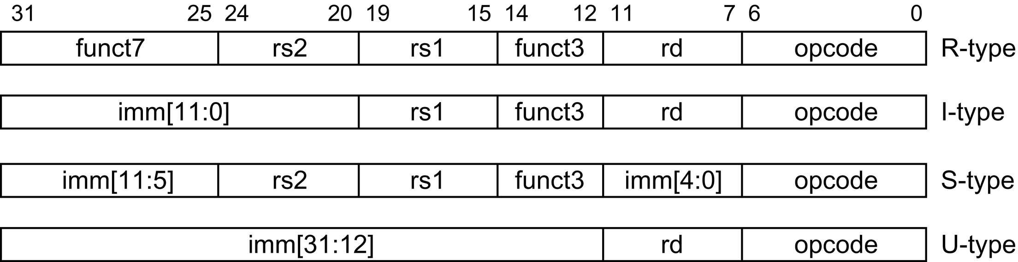
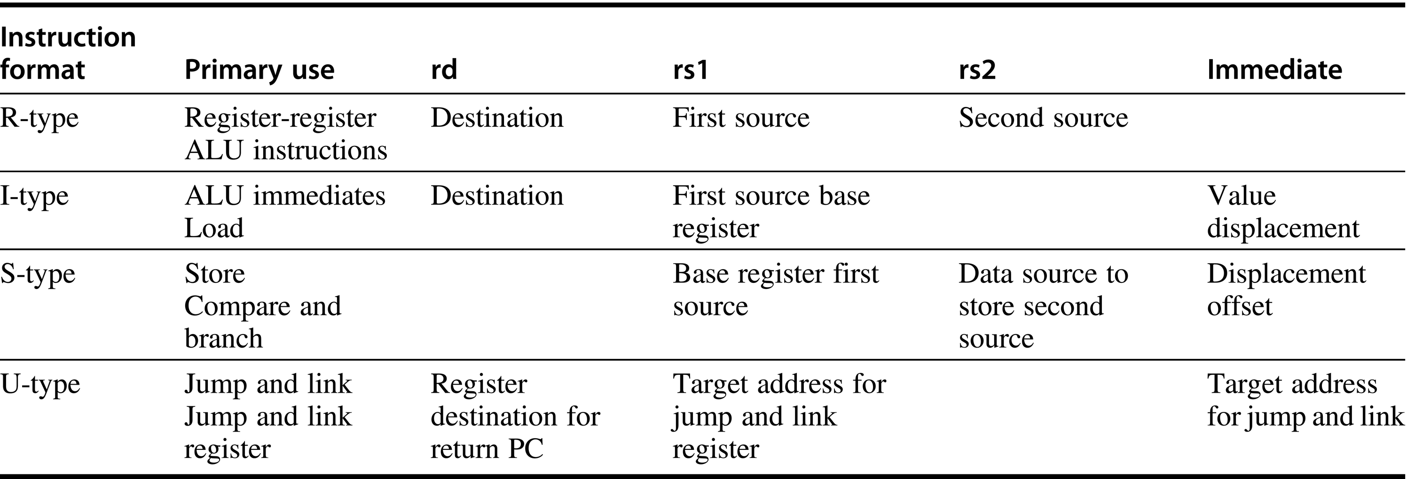
RV Instruction Formats
A.9 RISC-V Architecture

Slide 42
RV Encoding
A.9 RISC-V Architecture

Slide 43
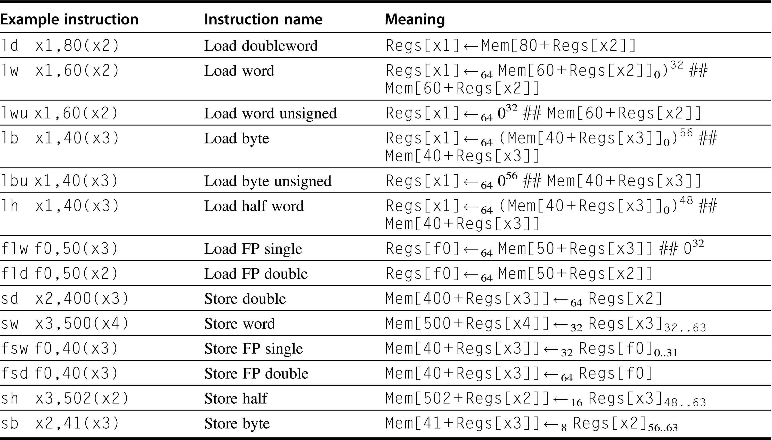
RV Load/Store Instructions
A.9 RISC-V Architecture

Slide 44
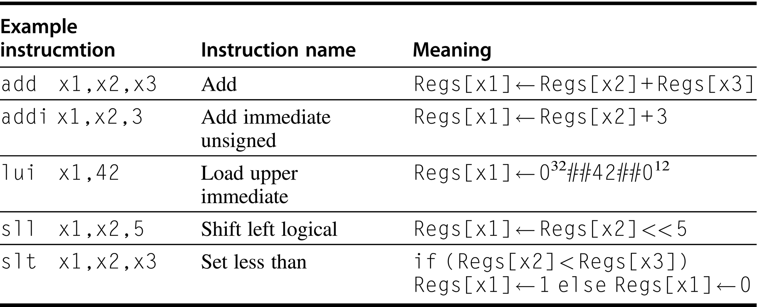
RV ALU Instructions
A.9 RISC-V Architecture

Slide 45
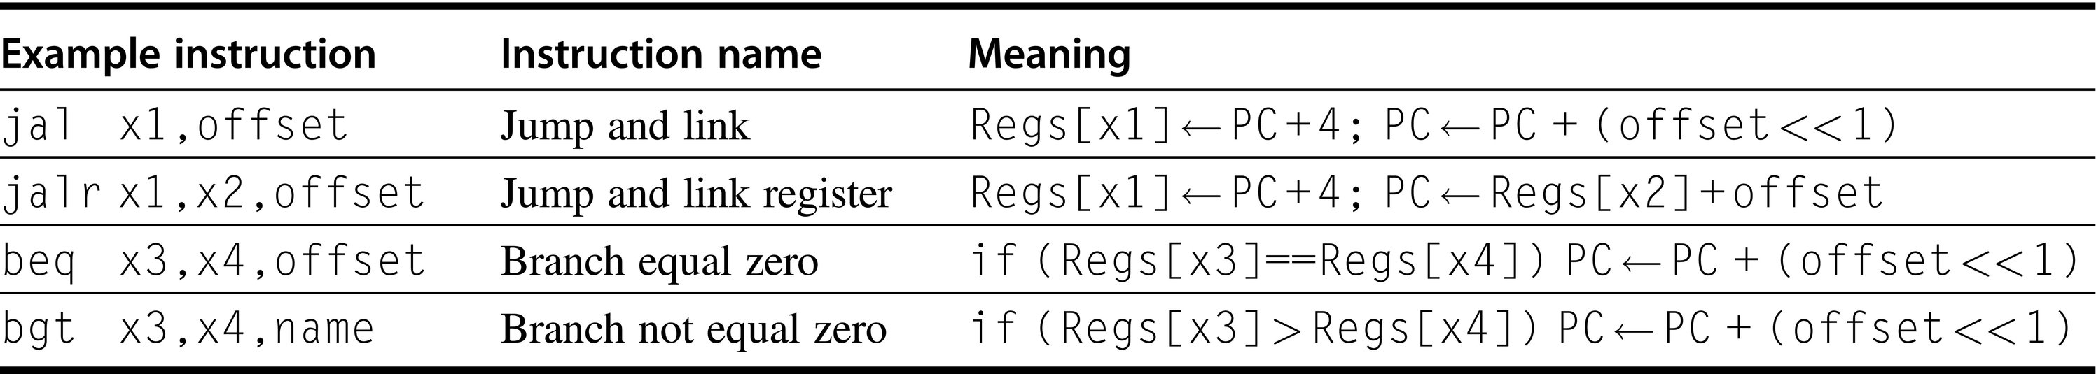
RV Control Flow Instructions
See App A and the RISC-V ISA Manual for more information
A.9 RISC-V Architecture

Slide 46
Backup

Slide 47
Types of Instructions
Operations supported by most ISAs
A.4 Types of Instructions
A.5 Operations in the Instructions

Slide 48
Instruction Distribution
Simple instructions dominate!
A.5 Operations in the Instructions

Slide 49
Control Flow Instructions
Conditional branches dominate!
SPEC CPU 2000 on Alpha
A.6 Control Flow Instructions

Slide 50
Conditional Branch Distances
4-8 bits can encode 90% branches!
SPEC CPU 2000 on Alpha
A.6 Control Flow Instructions

Slide 51
Branch Condition Evaluation
A.6 Control Flow Instructions
Notes:
example: if (x==5) then ... else ...

Slide 52
Types of Comparisons
SPEC CPU 2000 on Alpha
A.6 Control Flow Instructions

